Slide 1


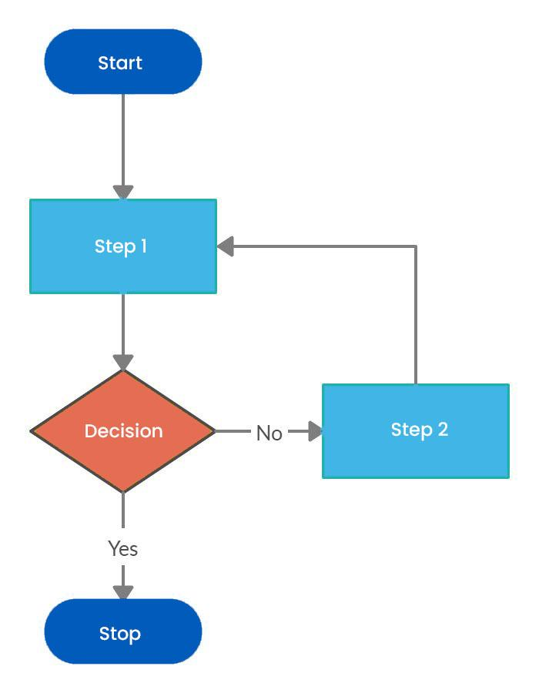
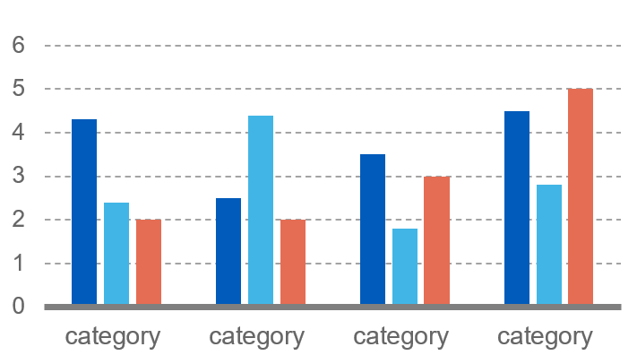

POSTER
NO.
01
Project Title
< Student Name 1 >, < Student Name 2 >, < Student Name 3 >, < Student Name 4 >, < Mentor Name >
Introduction
Conclusion
This template is designed to produce a A2 size poster in portrait orientation.
You can modify points or section size to be displayed as per your presentation need. The poster display should focus on:
Hypothesis or Objective
Methods or Mechanisms
Results or Outcomes
This section should include the problem statement or your research focus along with system block diagram and should answer the related research questions. This section can be about 200 words long.
About 250 words.
Without sounding like you are repeating yourself, start by reminding the viewer of your hypothesis and result.
Then discuss your results, why they are interesting, how the conclusion links back to your hypothesis and what could be the next step in this research in the future.
Results & Discussions
Results can be shown in form of tables or graphs or charts. Should be about 150 words.
Images of charts / tables/ graphs should be clear and readable.
References
Problem Statement
References are compulsory and should be in IEEE format
IEEE standard
Book,
[1] J. F. Curtis, (Ed.), Processes and Disorders of Human Comm-unication. New York: Harper and Row, 1978.
Journal Paper,
[2] J. Schroeterand M. M. Sondhi, “Techniques for estimating vocal-tract shapes from the speech signal,”IEEE Trans. Speech Audio Process., vol. 2, no. 1, pp. 133–150, 1994.
Proceeding paper,
[3] J. M. Pardo, “Vocal tract shape analysis for children,” in Proc. IEEE Int. Conf. Acoust., Speech, Signal Process., 1982, pp. 763–766.
Proceeding paper,
[4] J. M. Pardo, “Vocal tract shape analysis for children,” in Proc. IEEE Int. Conf. Acoust., Speech, Signal Process., 1982, pp. 763–766.
Define the problem statement and objectives.
TABLE SAMPLE
1998 | 1999 | 2000
2001 | 2002 | 2003
2004 | 2005 | 2006
Methodology
About 150 words. Briefly describe the methods/procedures used and how they will help you find out about your hypothesis. Could use flow diagrams to help illustrate your procedures (this will help break up your text and make the poster look more interesting). Ensure you label diagrams if needed.
Methods can be explained with flowchart or pseudocode . Your contribution should be highlighted.
Findings or Results of the algorithms used can be shown in this section.

